Slide 1


SIFs
Search In Video Frames

Slide 2
Problem Statement
Youtube
Education Videos

Slide 3
Provided Solutions
Panpto
Algoritmia

Slide 4
Methodology and steps
Get videos then write the object’s name to search
Analysis the videos and get the frames by openCV library
detect the objects in every frame
Recognize and tag the objects
Showing the videos that contain this object and the time that is appear

Slide 5
What is a video ?
Video is just an order set of frames of the same resolution, usually frames are taken at regular time intervals. When constructing the video procession algorithm, we divide the video into two classes(Video stream and Video Sequence)

Slide 6
What is the video frame ?
Video frames are individual pictures in a sequence of images. For example, a Flash movie that you see on the Web may play 12 frames per second, creating the appearance of motion. Most video is shot at 24 or 30 frames per second, or FPS

Slide 7
About Video frame rate
A frame rate is simply the frequency at which independent still images appear on the screen. This means that you can choose the number of stills that are displayed in one second.
If you increase the number of frames per second the figures in the shot will appear to be moving slower, while if you decrease the frame rate the characters in the shot will move faster, like in the early Charlie Chaplin movies.

Slide 8
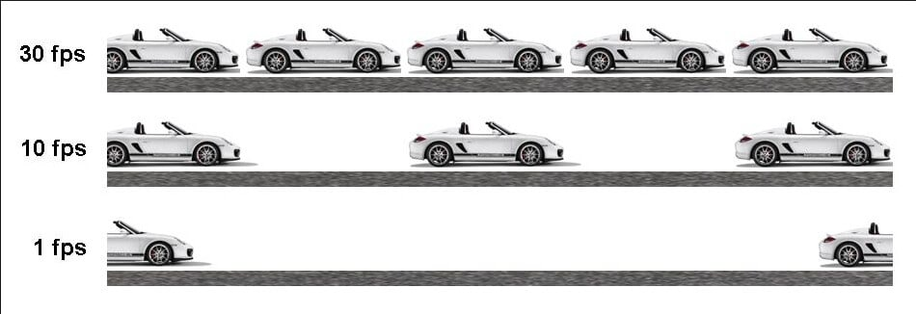
Most commonly used frame rates
A Large majority of DSLR and movie cameras offer only three different frame rates, the standard 24fps, 30fps for those who want to produce videos in the style of TV shows, and 60fps for sports and all other scenes that involve rapid motion.

Slide 9

Open computer vision library
OpenCV (Open Source Computer Vision Library) is an open source computer vision and machine learning software library. OpenCV was built to provide a common infrastructure for computer vision applications and to accelerate the use of machine perception in the commercial products.

Slide 10
Why we used OpenCV ?
First and foremost, OpenCV is available free of cost
The library has more than 2500 optimized algorithms
It has C++, Python, Java and MATLAB interfaces and supports Windows, Linux, Android and Mac OS.
OpenCV comes with many powerful video editing functions
OpenCV library can be used to perform multiple operations on videos

Slide 11
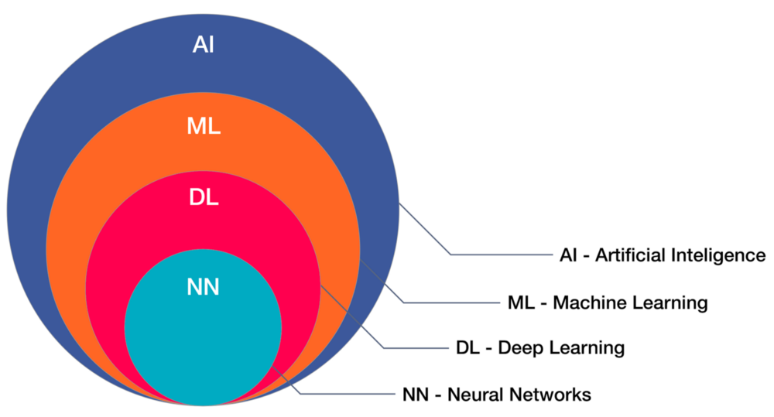

Slide 12
What’s AI ?
Artificial intelligence (AI) is the simulation of human intelligence processes by machines, especially computer systems. Specific applications of AI include expert systems, natural language processing (NLP), speech recognition and machine vision.

Slide 13
What is machine learning ?
Machine Learning A branch of artificial intelligence where engineers and scientists manually select features within the data and train the model. Common machine learning algorithms include decision trees, support vector machines, neural networks, and ensemble methods

Slide 14
What is deep learning ?
Deep Learning A branch of machine learning modeled loosely on the neural pathways of the human brain where the algorithm automatically learns what features are useful. Common deep learning algorithms include convolutional neural networks (CNNs), recurrent neural networks, and deep Q networks

Slide 15
What is neuron ?
In biology Neurons (also called neurons or nerve cells) are the fundamental units of the brain and nervous system, the cells responsible for receiving sensory input from the external world, for sending motor commands to our muscles, and for transforming and relaying the electrical signals at every step in between

Slide 16
Artificial neural Networks Algorithm
Artificial Neural Network is a set of connected input/output units where each connection has a weight associated with it started by psychologists and neurobiologists to develop and test computational analogs of neurons

Slide 17
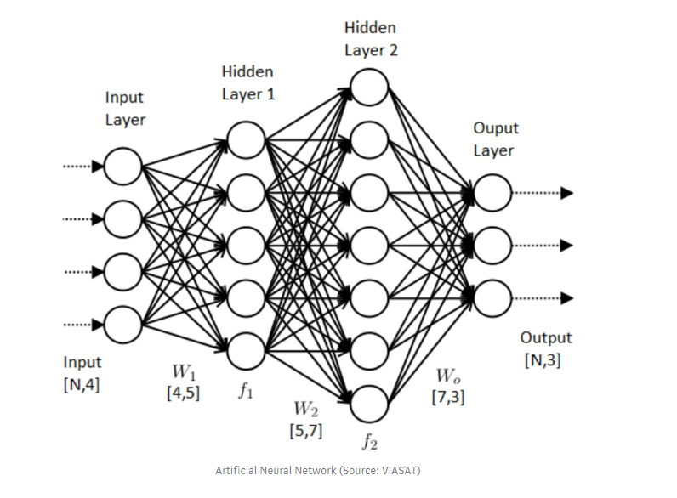
Neural Networks(NN)

Slide 18
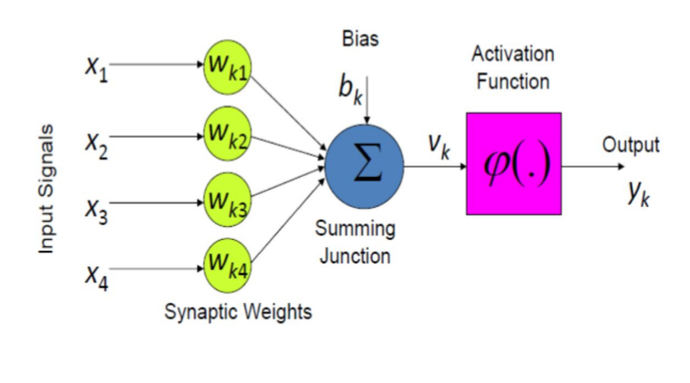
Components of simple neuron
Input Vector
Scalar output
Synapses change input
Adjustable weights
Activation Function

Slide 19
Activation function
Activation functions are really important for an Artificial Neural Network to learn and make sense of something really complicated and Non-linear complex functional mappings between the inputs and response variable

Slide 20
Most popular types of Activation functions
Sigmoid or Logistic
Tanh - Hyperbolic tangent
ReLu -Rectified linear units

Slide 21
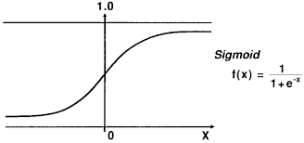
sigmoid function
A sigmoid function is a mathematical function having a characteristic "S"-shaped curve or sigmoid curve

Slide 22
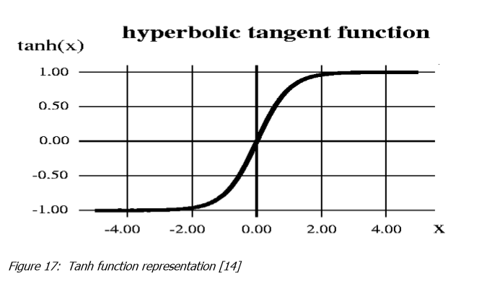
Hyperbolic Tangent function- Tanh
Hyperbolic Tangent function- Tanh: its mathematical formula is f(x) = 1 — exp(-2x) / 1 + exp(-2x).
It’s range in between -1 to 1

Slide 23

ReLu- Rectified Linear units
ReLu- Rectified Linear units: It was recently proved that it had 6 times improvement in convergence from Tanh function. It’s just R(x) = max(0, x)

Slide 24
Cost Function
It is a measure of "how good" a neural network did with respect to its given training sample and the expected output. It also may depend on variables such as weights and biases. A cost function is a single value, not a vector, because it rates how good the neural network did as a whole
input X provides the initial information that then propagates to the hidden units at each layer and finally produce the output.
This called forward propagation

Slide 25

Note :
The higher cost function, the most neural network suffers from some problems.
Our goal to reduce the cost function value
How to reduce the cost?

Slide 26

Solution
To do this we will use
Back-propagation
What is Back-propagation?

Slide 27
Back-propagation
Back-Propagation Allows the information to go back from the cost backward through the network in order to compute the gradient.
Doing so will help us know who is responsible for the most error and change the parameters in that direction

Slide 28
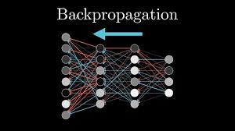

Slide 29
What is the purpose of all that?

Slide 30
The purpose of all that, to construct a model

Slide 31

What is the model?
A model said in a very simplified form is nothing but a function that is used to take in certain input, perform certain operation to its best on the given input (learning and then predicting/classifying) and produce the suitable output.
Our problem is training the model because our PCs can’t train a model

Slide 32
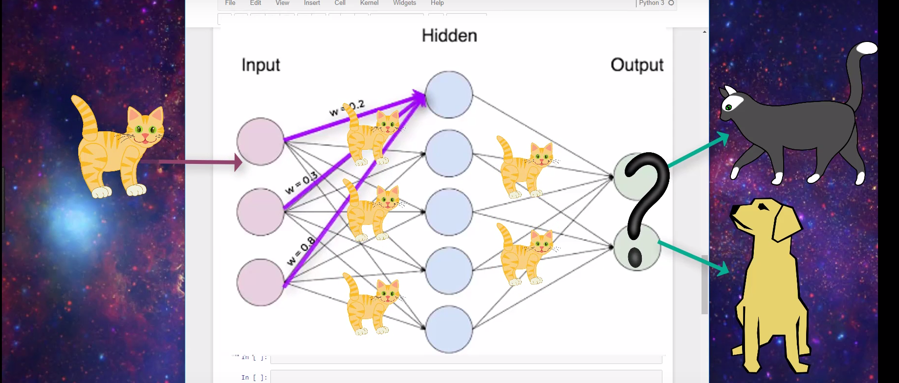
Training the model

Slide 33
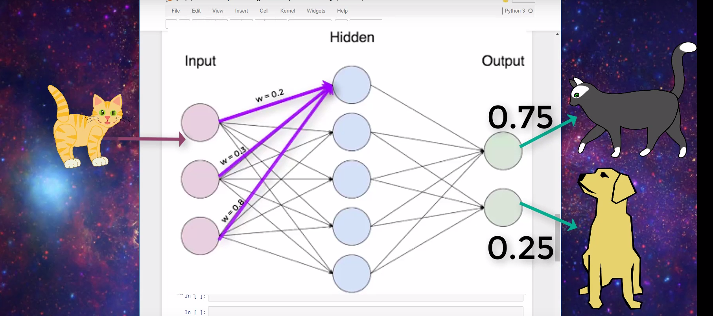

Slide 34
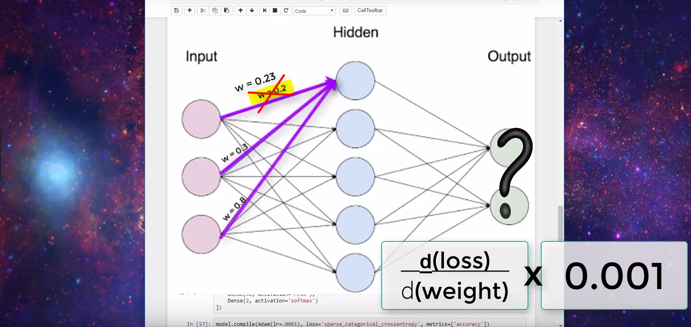

Slide 35
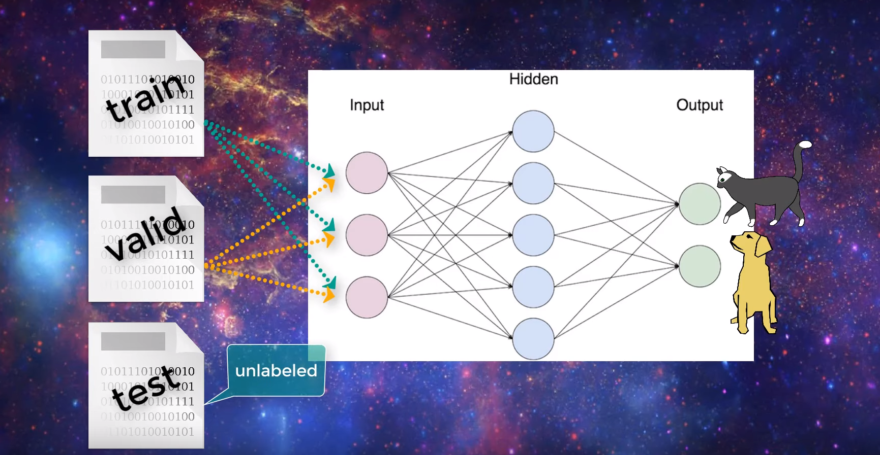

Slide 36
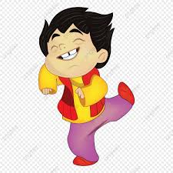
Model type that used in this problem
We found Solution is to use Pre-Traind Model
What is the pre-Trained Model?

Slide 37
Pre-Trained Model
A pre-trained model is a model created by some one else to solve a similar problem. Instead of building a model from scratch to solve a similar problem, you use the model trained on other problem as a starting point.

Slide 38
The common pre-Trained models used in Object Detection
R-CNN
Fast R-CNN
Faster R-CNN
Mask R-CNN
SSD(single shot multibox defender)
YOLO (You Only Look Once)
Objects as Points
Data Augmentation Strategies for Object Detection

Slide 39
Deep Learning Approaches
The three classic Deep Learning Algorithms are Region Proposals(R-CNN), Single Shot Multibox Detector(SSD), You Only Look Once (YOLO), and Single Shot Refinement Neural Network for Object Detection (RefineDet).

Slide 40
Pre-Traind model used
The Pre-Traind Model that used in this problem Is YoloV3
What is Yolo V3 ?

Slide 41
Yolo V3
YOLOv3 (You Only Look Once):
It is a model for object detection. The object detection task consists of determining the location on the image where certain objects are present, as well as classifying those objects.
YOLO v3 uses a variant of Darknet, which originally has 53 layer network trained on Image net Darknet Architecture is pre-trained model for classifying 80 different classes. Our goal now is that we will use Darknet (YOLOv3) to classify objects using Python language.

Slide 42
How Yolo V3 Work ?
They apply the model to an image at multiple locations and scales
High scoring region of the image are considered detections.
We apply a single neural network to the full image
This network divides the image into regions and predicts bounding boxes and probabilities for each region

Slide 43

Why we use Yolo v3 in this problem?
-This model make prediction for large number of objects are 80 objects.
-This model is so fast because it is look to the image once and predict the objects on it.
-This model is pre-traind.

Slide 44
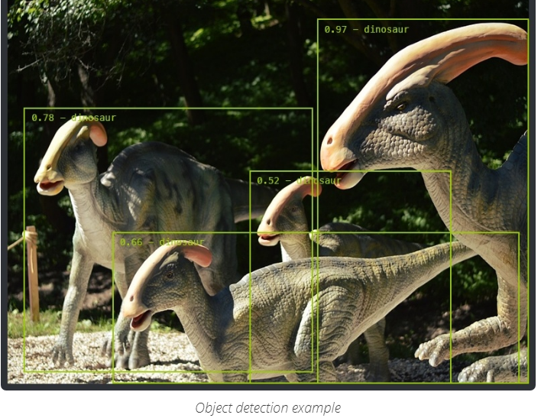
Object Detection
Object detection is the problem of finding and classifying a variable number of objects on an image

Slide 45
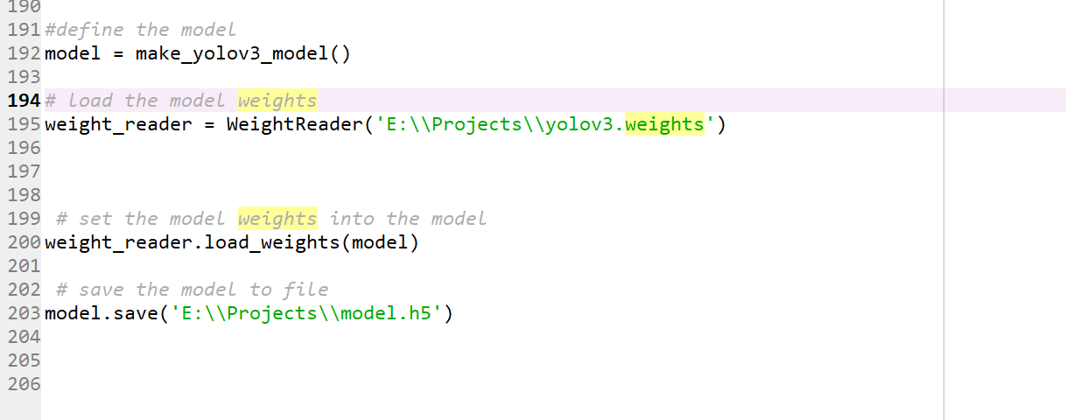
Read and save modl

Slide 46
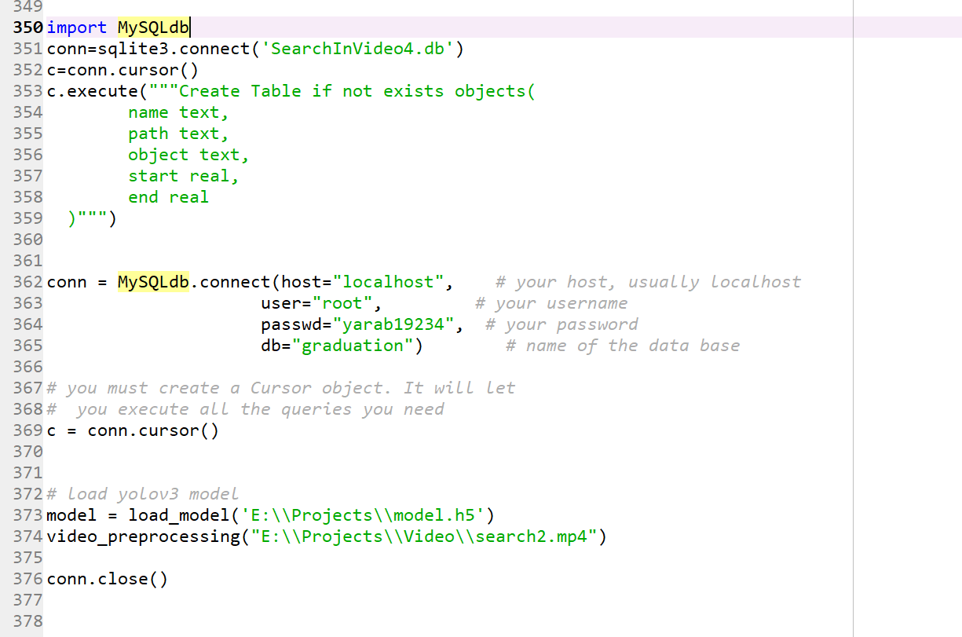
Main

Slide 47
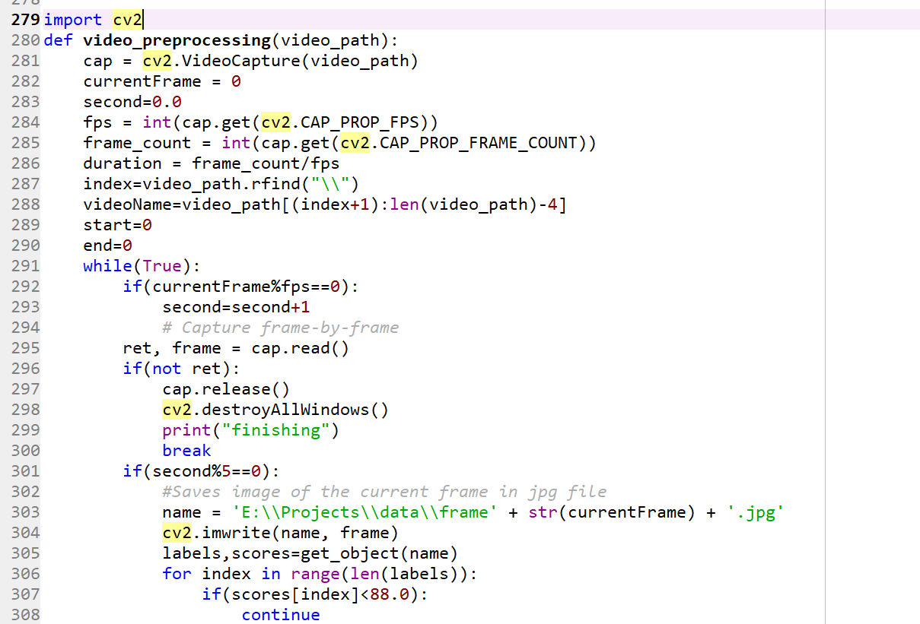
Video preprocessing

Slide 48
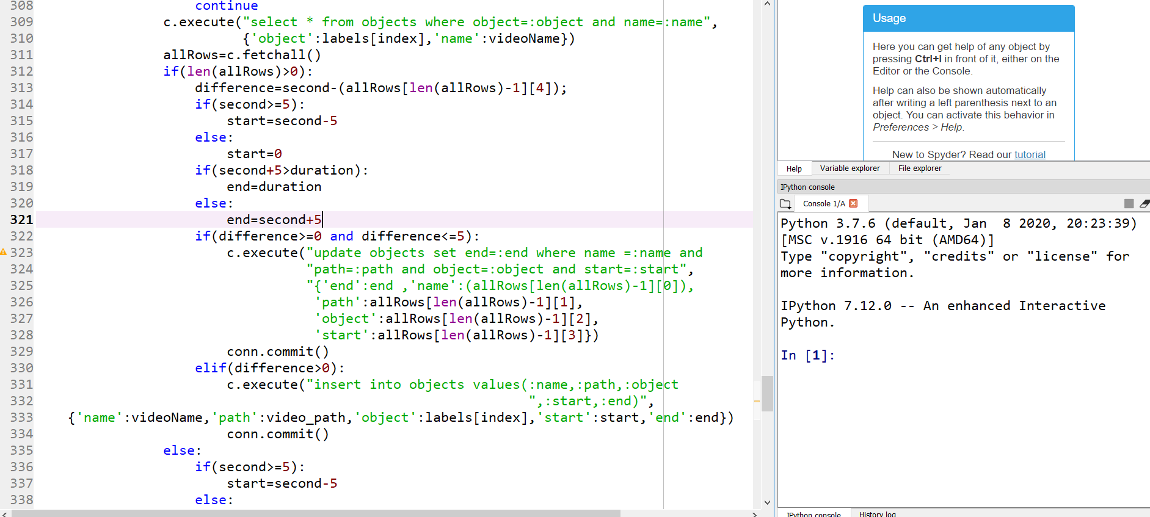
Video preprocessing

Slide 49
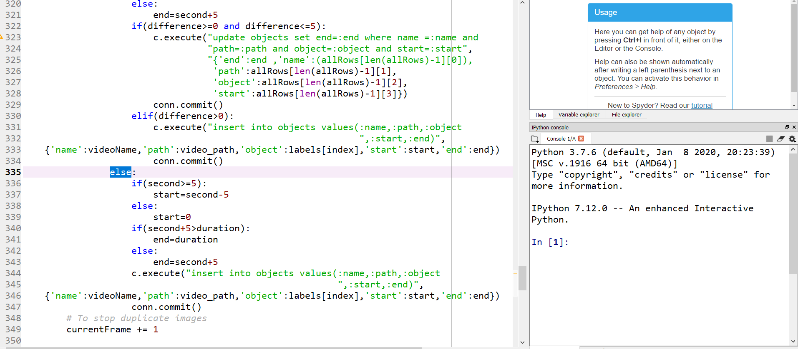
Video preprocessing

Slide 50
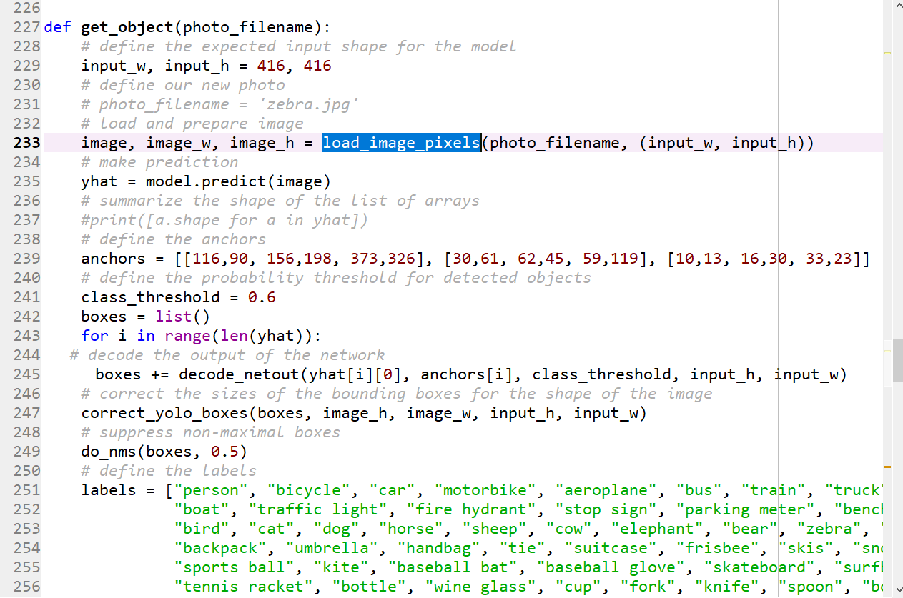
Get object

Slide 51
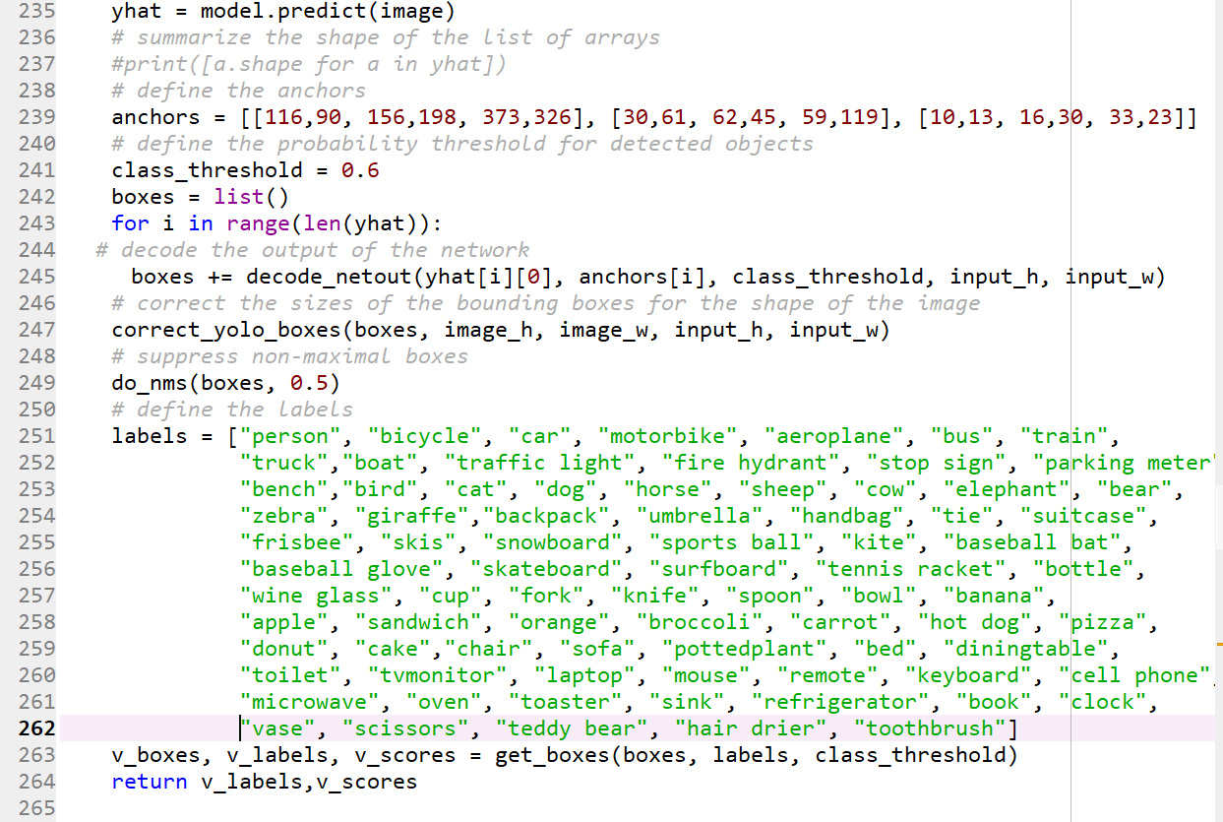
Get object

Slide 52
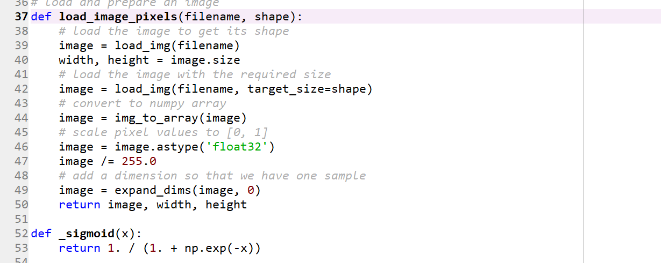
Load image pixels

Slide 53
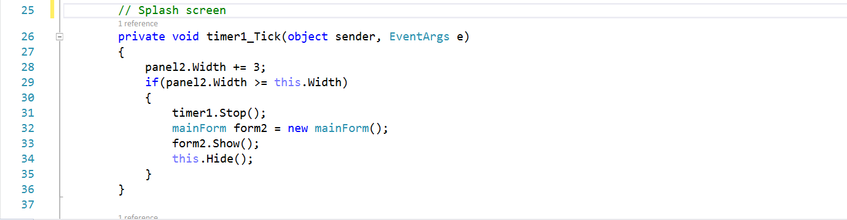
Splash Screen GUI

Slide 54
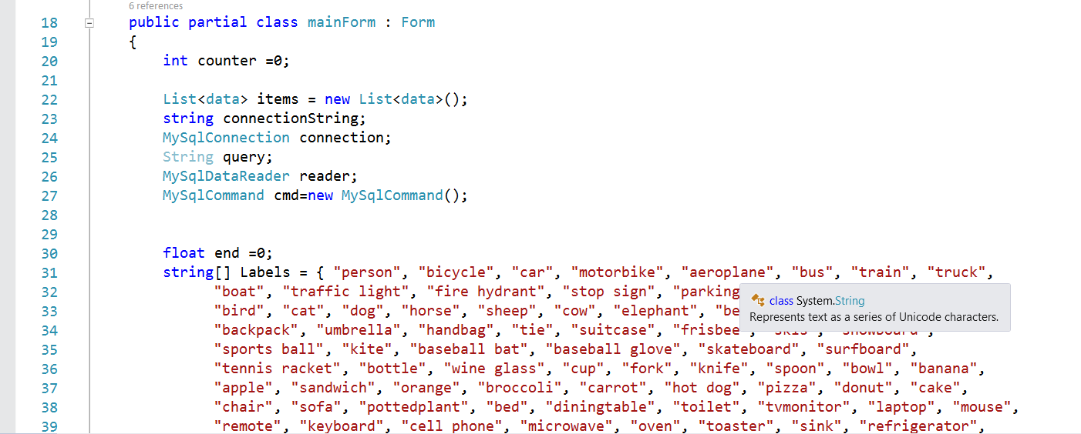
Main form

Slide 55
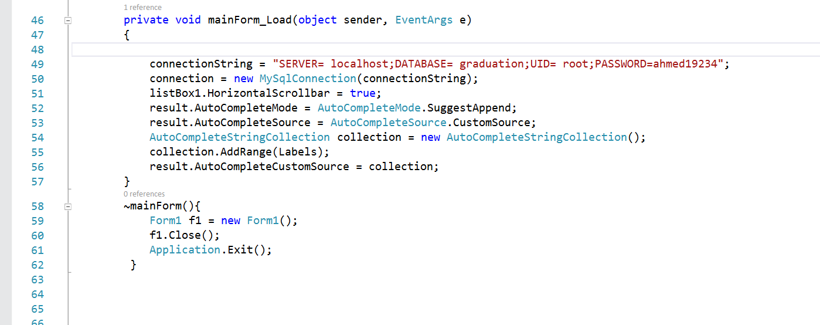
Main form load

Slide 56
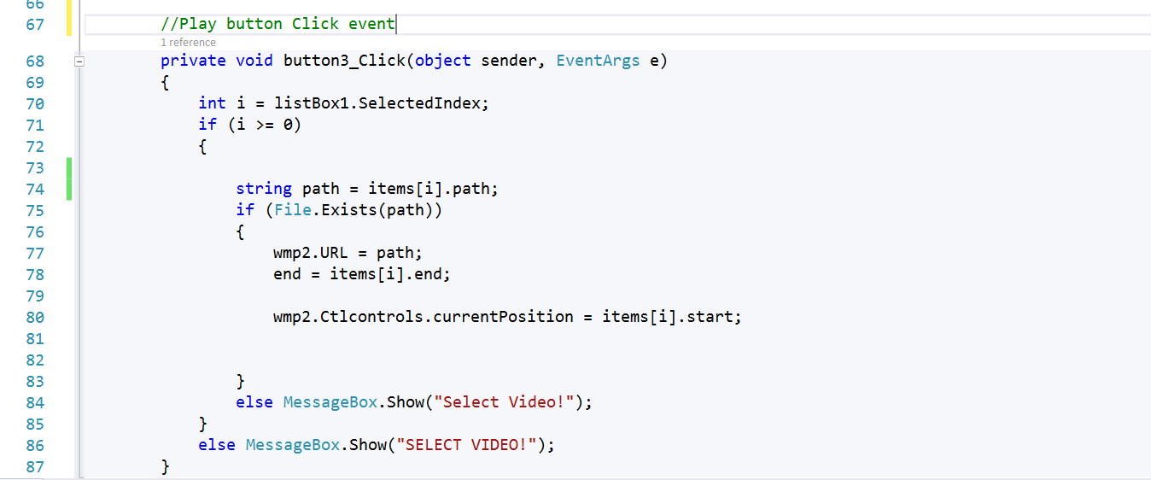
Play button click event

Slide 57
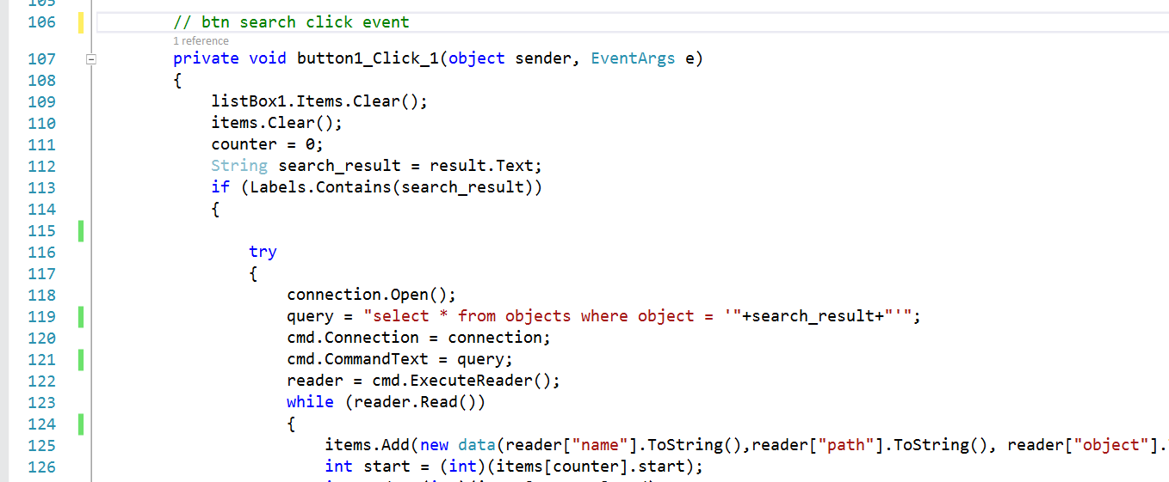
Search button click event

Slide 58
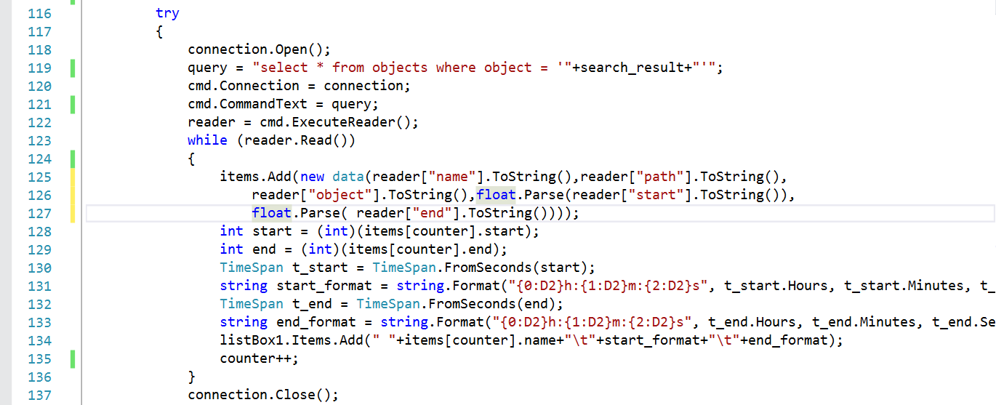
Search button click event

Slide 59
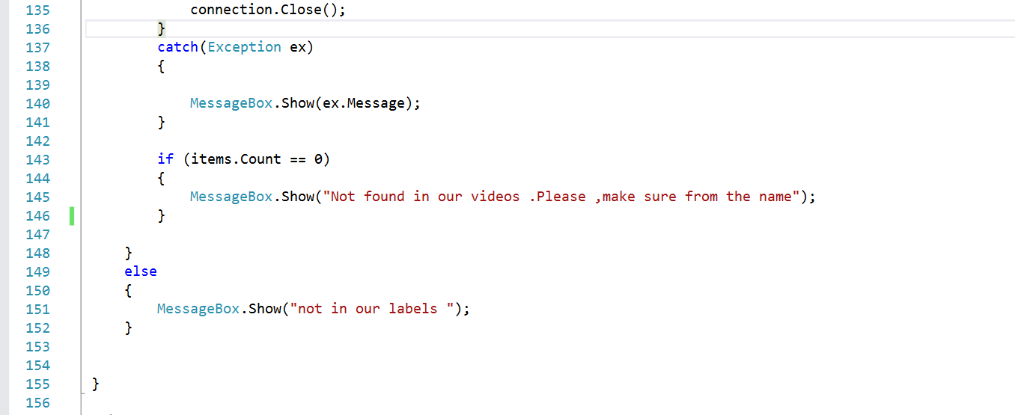
Search button click event

Slide 60

Project Work

Slide 61
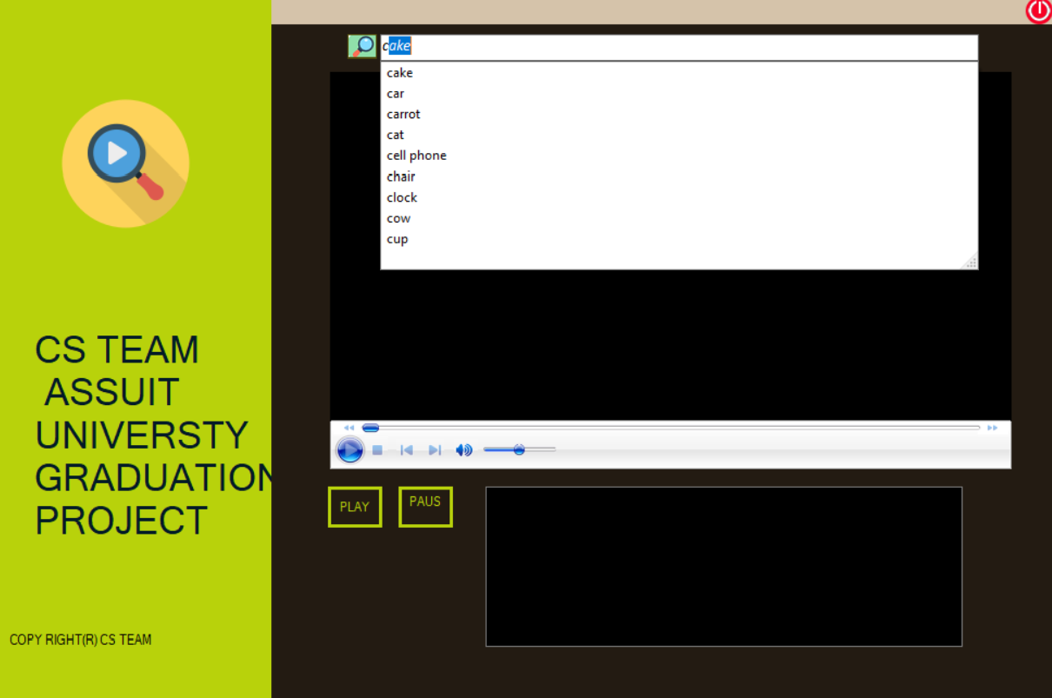

Slide 62
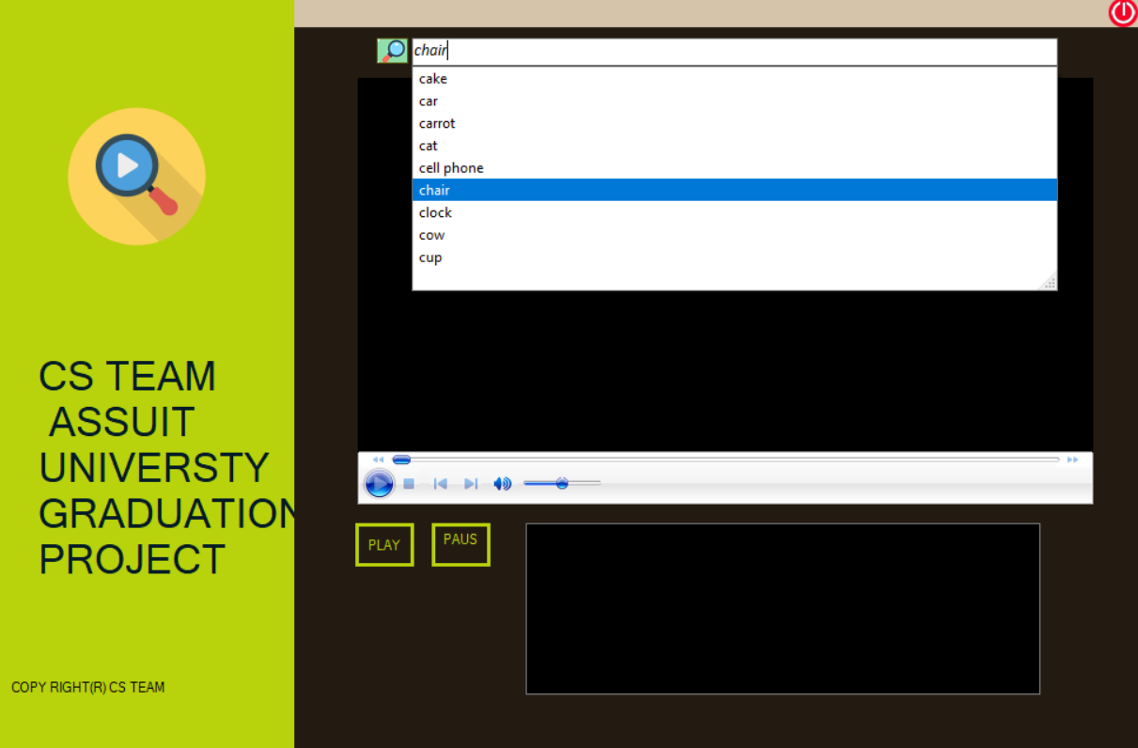

Slide 63
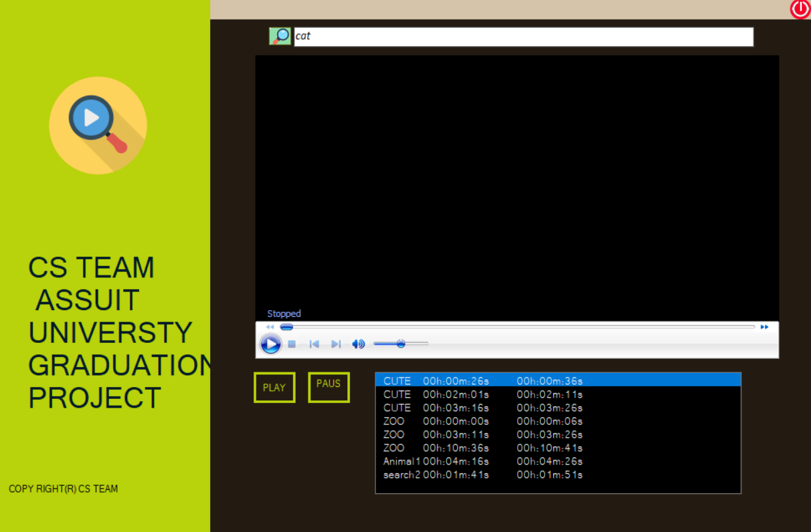

Slide 64
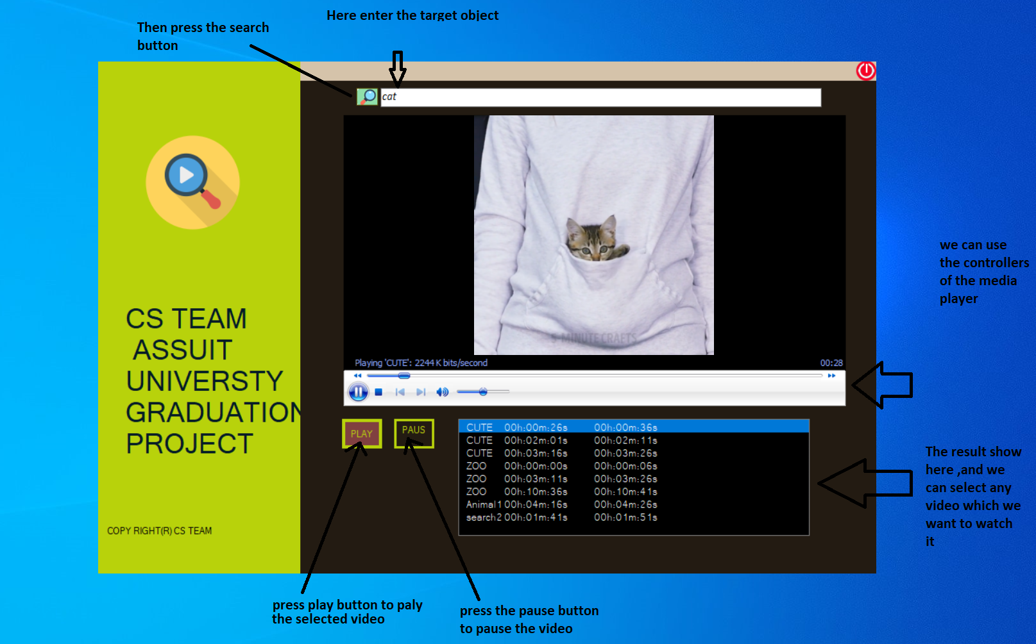

Slide 65
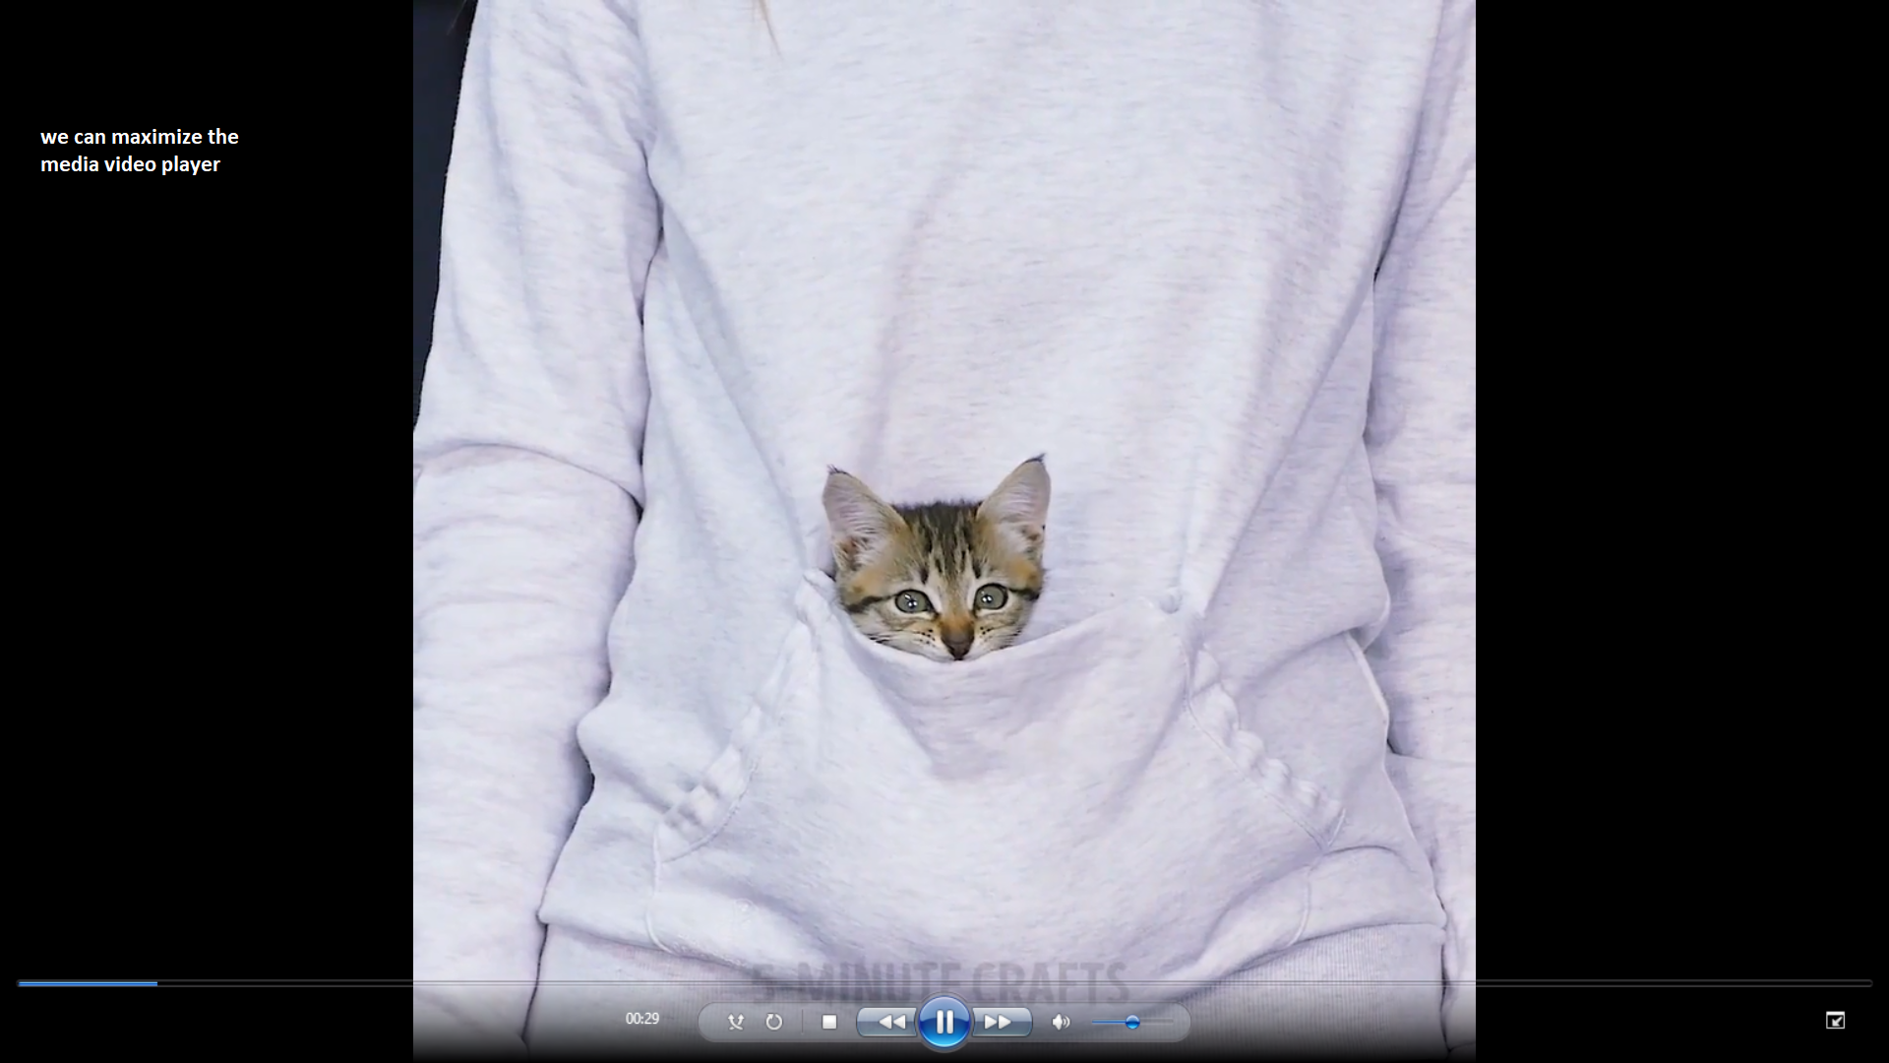

Slide 66
The End

